Slide 1
Software Quality
SE401: Software Quality Assurance and Testing

Slide 2
Outline
Factors in Project Success & Failure
A Case Study, The Initial Launch of HealthCare.gov
Software Reliability
The Spectrum of Software Quality
Cost of Software Defects
Software Verification and Validation (V&V)
Software Testing in Development Life Cycle
Artifacts to Facilitate Software Testing

Slide 3
Factors in Project Success & Failure

Slide 4
Software Crisis
Many software-related failures: auto-pilot systems, air traffic control systems, banking systems, IRS.
On January 15, 1990, the AT&T long-distance telephone network broke down, interrupting long-distance telephone services in US for over 8 hours. [Missing break in a switch statement.]
On June 4, 1996, the maiden flight of the new and improved Ariane 5 rocket exploded 37 seconds after lift-off.
On June 8, 2001, a software problem caused the NYSE to shut down the entire trading floor for over an hour.
On May 27, 2017, a software problem caused a disruption for 75,000 passengers in British Airways
February 2020: Heathrow disruption, More than 100 flights were disrupted after it was hit by technical issues
Many, many, many more.

Slide 5
What is the problem?
Software Projects have a terrible track record
A 1995 Standish Group study (CHAOS) [see notes] found that only 16.2% of IT projects were successful in meeting scope, time, and cost goals (on-time & on-budget) [Things have improved a bit since.]
Over 31% of IT projects were canceled [never seeing completion], costing over $81 billion in the U.S. alone
They never worked
Too late for the market window
Most projects are
Late in delivery
Missing functionality
Have major defects (bugs)
Did not do what the customer wanted
Hard to maintain and support
Notes:
According to the Standish Group ¹, in 1995, U.S. government and businesses spent approximately $81 billion on canceled software projects, and another $59 billion for budget overruns. Their survey claimed that in the United States, only about one-sixth of all projects were completed on time and within budget, nearly one third of all projects were canceled outright, and well over half were considered "challenged." Of the challenged or canceled projects, the average project was 189 percent over budget,222 percent behind schedule, and contained only 61 percent of the originally specified features.
See the new paper: Phillip G. Armour, "Twenty Percent: Planning to fail on software projects", CACM, Vol. 50, No. 6 (June 2007), p 21-23. (D2L > Documents)
The. Standish Group, "Chaos," 1995, http://www.standishgroup.com/chaos.html.

Slide 6
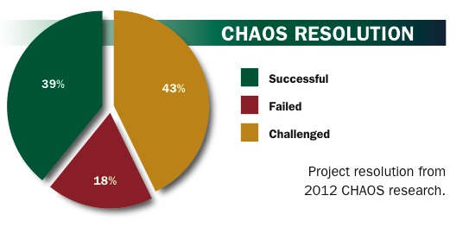
Chaos Report 2012
Project Success: Type 1. The project is completed on-time and on-budget, with all features and functions as initially specified. (2012: 39%)
Project Challenged: Type 2. The project is completed and operational but over-budget, over the time estimate, and offers fewer features and functions than originally specified. (2012: 43%)
Project Impaired: Type 3. The project is canceled at some point during the development cycle. (2012: 18%) (Are ALL impaired projects failures???)

Slide 7
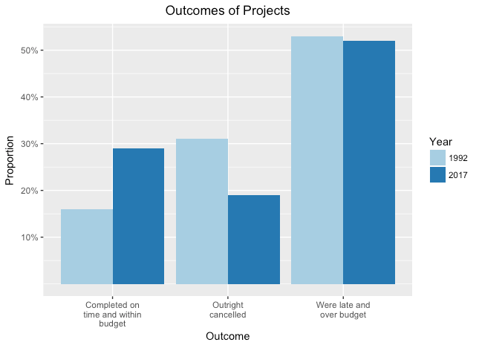
1992-2017

Slide 8
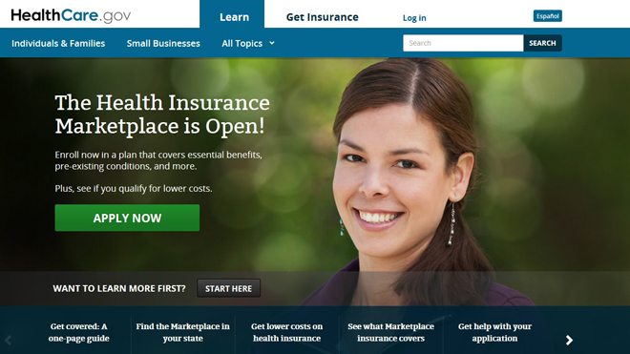
A Case Study The Initial Launch of HealthCare.gov (2013)

Slide 9
ACA – HealthCare.gov
ACA signed into law on March 23, 2010
HealthCare.gov is a healthcare exchange website.
“One-stop shopping sites for health insurance”
CBO forecast: 7 million users during the first year
Development contracts awarded in September 2011
No-bid, cost-plus contracts
Pre-certified private contractors
HealthCare.gov launched on October 1, 2013
Serious technological problems
Notes:
Affordable Care Act (ACA)
Congressional Budget Office (CBO)

Slide 10
HealthCare.gov – The Launch Problems
Performance: response time (landing page) > 8s
“Maddeningly long wait times"
Navigation: broken UI
Stability: intermittent crashes, availability ≈ 43%
Functionality: incorrect and incomplete data
Error rate (per page) ≈ 6%
Scalability: < 1,100 concurrent users
Enrollment completion rate < 30%
Notes:
Error rate: time out or fail

Slide 11
HealthCare.gov – The Contractors & The Cost
The lead contractor: CGI Group
At least 47 private companies involved
Including QSSI, Equifax, Serco
Coordinated by the Centers for Medicare and Medicaid Services (CMS)
Total budget: $293 million
CGI: $196 million (2013). $112 million paid Oct. 2013
QSSI: $85 million
Estimated actual cost: > $500 million by Oct. 2013

Slide 12
HealthCare.gov – The Failures – Software Eng.
Inadequate Testing
“This system just wasn't tested enough.” – CMS
Full test began T -2 weeks (time before launch).
Final “pre-flight checklist” T -1 week: 41 of 91 functions fail.
No “end-to-end” test as late as T -4 days
Stress tests T -1 day: performance degradation with only 1,100 concurrent users. (50,000-60,000 expected)
Final top-to-bottom security tests not finished.
No integration test. No beta test.

Slide 13
HealthCare.gov – The Failures – Software Eng.
Evolving, Rolling Requirements
Regulations and policies were still in flux when contracts awarded in 2011.
The specifications for the project were delayed repeatedly.
The regulations and policies were modified repeatedly until summer 2013.
Repeated changes result in design changes.
CGI did not start coding until Spring 2013
Failure to Effectively Manage Changes
“Write-down-all-the-requirements-then-build-to-those-requirements”
Did not adopt an agile development approach.
Committed to an all-or-nothing launch date.

Slide 14
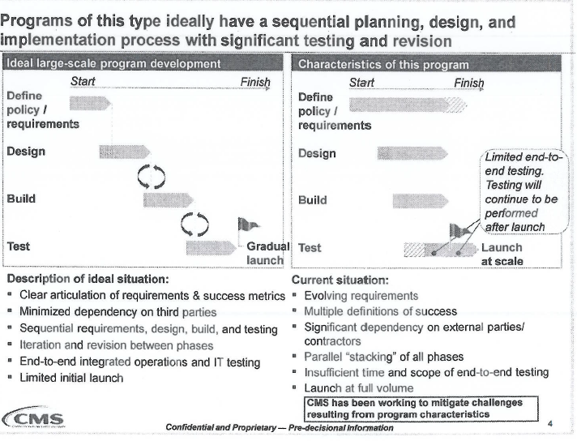
Case Study: HealthCare.gov– McKinsey “Red Team” Assessment

Slide 15
Case Study: HealthCare.gov: The Failures – Management
Management expertise is in getting contracts not delivering projects.
Project quality is sacrificed for the sake of appearances.
Seriously substandard staffing and under staffing
CGI. Three months before launch, only 10 developers were working on a crucial part of the site , and of those, only one was "at a high enough skill level.”
Lack of coordination among contractors
Unclear responsibilities. Fragmented authority.

Slide 16
Case Study: HealthCare.gov: The Failures – Gov. & Policies
Government IT projects
Most are over budget and/or behind schedule.
“Write-down-all-the-requirements-then-build-to-those-requirements” is outdated.
IT procurement policies
Cost-plus contract, no-bid contracts
“The firms that typically get contracts are the firms that are good at getting contracts, not typically good at executing on them.”

Slide 17
Case Study: HealthCare.Gov – Dec. 2013
400+ bug fixes, by the end of Nov. 2013
“Operate smoothly for most users.” – W.H.
Availability > 90%
Response time (landing page) < 1s
Error rate (per page) < 1%
Completion rate ≈ 80%
System capacity ≈ 50,000 concurrent users
Sign-ups
27,000 in Oct, 110,000 in Nov, 975,000 in Dec

Slide 18
Case Study: HealthCare.Gov – April 2014
Issues on data accuracy and completeness
Estimated 10-15% of sign-ups missing
Other inaccuracies have been reported
CGI work during repair continue to be substandard
Half of the software fixes failed. – CMS
CGI contract has been terminated. (Jan. 10, 2014)
March 31, 2014 (last day to sign up), site went down
April 1, 2014. 7.1 million signed up – W.H.

Slide 19
Case Study: HealthCare.Gov – Aftermath
Accenture took over in Jan. 2014 as the lead contractor for development and maintenance: $175M
Cost of building the system – GAO, July 2014
$834M through Feb. 2014
Total estimated cost: > $2B
“CMS undertook the development of HealthCare.gov without effective planning or oversight practices”
Also found “increased and unnecessary risk of unauthorized access, use, disclosure, modification or loss” of information
CMS only withheld $267,000 in requested fees, 2% of the contract, from CGI.

Slide 20
Case Study: HealthCare.Gov – 2015 Enrollment Cycle
Enrollment for 2015 (37 states)
Nov 15, 2014 – February 15, 2015.
Outages on the first day
More smooth operation thereafter
February, 2015
~ 11.4 million sign-ups (~8.6 million re-enrollments)
Open enrollment extensions: March 15 – April 30
~800,000 received incorrect tax information,
Incorrect amount on 1095-A Form

Slide 21
Case Study: HealthCare.gov: The Lessons Learned
Adopt software engineering best practices
Agile software development. Testing early.
Software quality assurance and testing. Testing throughout.
Adopt management best practices
Clear responsibility and accountability
Performance metrics and progress tracking
Revamp government IT procurement policies
Current system is antiquated, and has failed.
Bring government IT to the 21st century.

Slide 22
Software Reliability

Slide 23
Metrics of Software Quality – Performance & Scalability
Performance
The ability to complete requested functions or services within the expected time span by the users.
e.g., average response time for a given task
Scalability
The capacity of a system to handle increasing load or demand.
e.g., # of concurrent users, # of transactions per second, # of requests per second

Slide 24
Product Quality Metrics
Two key metrics for intrinsic product quality are Mean Time To Failure (MTTF) and availability
MTTF is most often used with safety critical systems such as air traffic control systems, avionics, and weapons
Availability is the probability that a system will work as required when required during the period of a mission.
Both are correlated, but different in the same way that failures and defects are different

Slide 25
Metrics of Software Quality – Mean Time Between Failures
Mean time between failures (MTBF)
Average of intervals between consecutive failures.
Mean time to failures (MTTF)
Average amount of time a system operates before it fails
Mean time to repair (MTTR)
Average time to repair/restart the system and get it back to running
MTBF is a simple measure of reliability
MTBF = MTTF + MTTR

Slide 26
Metrics of Software Quality – Availability & Reliability
Availability
The probability of a system to be available.
The fraction of time the system is available.
available time (“up time”)
total time
Reliability
The probability of a system to operate without failures.
The fraction of all attempted operations that complete successfully.
# of successful operations
# of total operations attempted

Slide 27
Software Availability
Software availability is the probability that a program is operating according to requirements at a given point in time and is defined as
Availability = [MTTF/(MTTF + MTTR)] x 100%
Consider 5 nines availability (99.999%); what does this mean?
5 minutes of down time per year
[See Availability (system) – https://en.wikipedia.org/wiki/Availability_(system)]

Slide 28
Metrics of Software Quality – Error Rate & Completion Rate
Reliability depends on the unit of operation
An operation may consists of multiple steps
Reliability ≠ Completion rate
Error rate (per page)
The fraction of pages (unit of operation) that time out or fail
Completion rate
The fraction of all attempted operations that eventually complete the operation
Completion ≠ Success

Slide 29
Integration & System Testing
Integration testing
To expose defects in the interfaces and the interactions between integrated sub-systems.
System (“end-to-end”) testing
Test of an integrated system to determine whether it meets the specification.

Slide 30
Acceptance & Beta Testing
Acceptance testing
To determine whether or not a system satisfies the user needs and requirements.
To enable the user, customers, or other authorized entity to determine whether or not to accept the system.
Beta testing
One form of acceptance testing
Performed by real users in their own environment
Perform actual tasks without interference.

Slide 31
The Spectrum of Software Quality

Slide 32
What is Quality?
Some possible definitions:
Quality = zero defects (Crosby)
The totality of features and characteristics of a product or service that bear on its ability to satisfy specified or implied needs. (ISO)
Quality = fitness for purpose (Juran)
Quality n., the degree of excellence (OED)

Slide 33
Software System Qualities
Correctness
Availability
Reliability
Performance
Scalability
Efficiency
Safety
Usability
Security
Robustness
Maintainability
Reusability
Portability
Interoperability

Slide 34
On Expected Behavior – Correctness vs. Reliability
Correctness
Whether a system is consistent with its specification.
Reliability
The probability of a system to operate without failures.
Relative to its specification and a usage profile.
Statistical approximation to correctness
100% reliable ≈ correct

Slide 35
On Exceptional Behavior – Safety vs. Robustness
Safety
The ability of a software system to prevent certain undesirable behaviors, i.e., hazards.
Robustness
The ability of a software system to fail or degrade gracefully outside its normal operating parameters.
Acceptable (degraded) behavior under extreme conditions.

Slide 36
Correctness
Correctness is an all-or-nothing proposition.
A program cannot be mostly correct or somewhat correct or 30% correct, it is absolutely correct on all possible behaviors or else it is not correct.
It is very easy to achieve correctness, since every program is correct with respect to some (very bad) specification.
Correctness is a goal to aim for, but is rarely provably achieved.

Slide 37
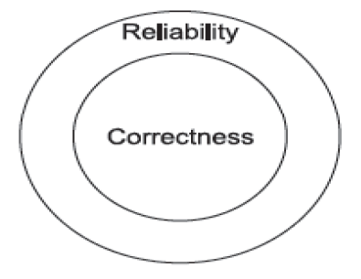
Reliability
Informally, software is reliable if the user can depend on it. The specialized literature on software reliability defines reliability in terms of statistical behavior—the probability that the software will operate as expected over a specified time interval.

Slide 38
Robustness
A program is robust if it behaves “reasonably,” even in circumstances that were not anticipated in the requirements specification
for example, when it encounters incorrect input data or some hardware malfunction (say, disk crash).
Obviously, robustness is a difficult-to-define quality

Slide 39
Correctness and reliability
Correctness and reliability are contingent on normal operating conditions.
Software that is “correct” may still fail when the assumptions of its design are violated. How it fails matters.
Software that “gracefully” fails is robust.
Consider events that could cause system failure.
Decide on an appropriate counter-measure to ensure graceful degradation of services.

Slide 40
Focusing on – Different Facets of the System
Correctness, reliability:
Let traffic pass according to correct pattern and central scheduling
Robustness, safety:
Provide degraded function when possible
never signal conflicting greens.
blinking red / blinking yellow is better than no lights
no lights is better than conflicting greens

Slide 41
Relationship Among the Qualities
reliable but not correct: failures occur rarely
robust but not safe: catastrophic failures can occur
Reliable
Robust
Correct
Safe
safe but not correct: annoying failures can occur
correct but not safe or robust: the specification is inadequate

Slide 42
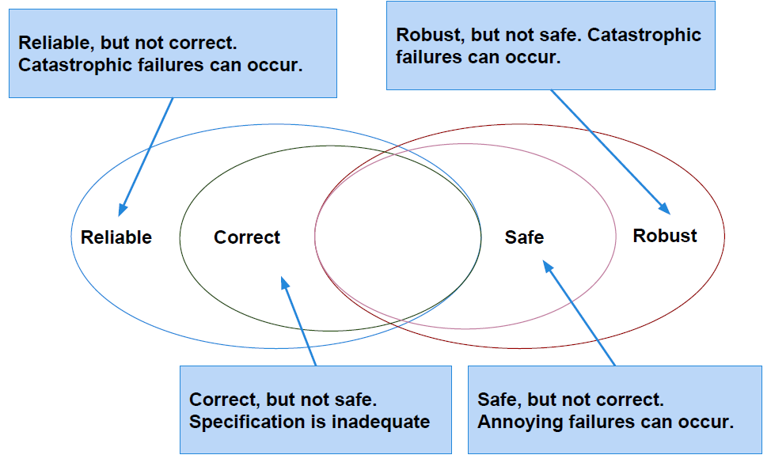
Relationship Among the Qualities

Slide 43
Performance Related Qualities
Performance
The ability to complete requested functions or services within the expected time span by the users.
Scalability
The capacity of a system to handle increasing load or demand.
Efficiency
The ability to make maximum and efficient use of system resources.

Slide 44
Usability & Security
Usability
The ability for the users to use all the features of the system without special efforts.
Security
The ability to maintain integrity of the system operation and the data.

Slide 45
Internal Qualities
Maintainability
The ability to make changes, enhance, adapt, and evolve a software system over a long period of time.
Reusability
The ability to use parts of the system in different project without special effort on the part of the developers
Portability
The ability to port a software system to a different platform or operating environment

Slide 46
Software Quality
Conformance to customers’ requirements

Slide 47
Quality
The American Heritage Dictionary defines quality as
“a characteristic or attribute of something.”
For software, two kinds of quality may be encountered:
Quality of design encompasses requirements, specifications, and the design of the system.
Quality of conformance is an issue focused primarily on implementation.
user satisfaction = compliant product + good quality + delivery within budget and schedule

Slide 48
Cost of Quality
Prevention costs include
Quality planning
Formal technical reviews
Test equipment
Training
Internal failure costs include
Rework
Repair
Failure mode analysis
External failure costs are
Complaint resolution
Product return and replacement
Help line support
Warranty work

Slide 49
Customers’ Expectations
What’s wrong with “performance to customers’ expectations” rather than requirements?
Often hear people say “We must exceed the customers’ expectations!”
What’s the basic problem with this?
The result is?

Slide 50
Software Quality
Conformance to explicitly stated functional and performance requirements, explicitly documented development standards, and implicit characteristics that are expected of all professionally developed software.
Quality must be defined and measured if improvements are to be achieved
In the narrowest sense, it is commonly recognized as the lack of “bugs” in the product
Also, the most basic meaning of conformance to requirements because if the software contains too many functional defects, the basic requirement of providing the desired function is not met
How is this usually expressed?

Slide 51
Application to Software
Simplistically, software product quality is lack of “bugs” in the product
Why is this problematical for software systems?
Correct operation is not sufficient – performance?
Usability by the end-user
Software specifications

Slide 52
Software Quality
The collection of attributes in a software system, the level of the attribute for which the customer and users holds a positive value.
It is best defined as “conformance to customers’ requirements”

Slide 53
Cost of Software Defects

Slide 54
Saving Time and Money
Even experienced software engineers inject a defect about every ten lines of code
The cost of finding and fixing defects increases at every step in the development process
The defect find & fix times range from 3 minutes in code reviews to 25 minutes in inspections and 1400 minutes in system testing
For accurate plans and reliable commitments, you must insist on what?

Slide 55
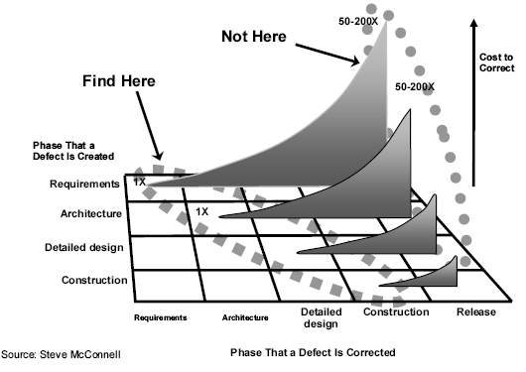
Cost of Software Defects

Slide 56
Estimated Cost of Fixing Defects
The earlier a defect is discovered, the lower the cost of fixing the defect.

Slide 57
Distribution of Defects – Time Introduced and Fixed
Majority of defects are introduced early
Majority of defects are discovered late.

Slide 58
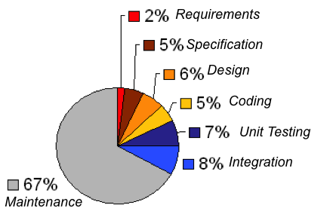
Cost by Development Phases

Slide 59
Software Verification and Validation (V&V)

Slide 60
Verification and Validation
Verification Does the software system meet the requirements specifications?
Are we building the software right?
Validation Does the software system meet the user's real needs?
Are we building the right software?

Slide 61
Software Specification
A document that specifies, ideally in a complete, precise and verifiable manner, the requirements, design, behavior, or other characteristics of a component or system, and, often, the procedures for determining whether these provisions have been satisfied. [IEEE]

Slide 62
Validation vs. Verification
SW Specs
Actual
Requirements
System
Validation
Verification
Includes
usability testing
user feedback
Includes
testing (mostly)
inspections
static analysis
Notes:
62

Slide 63
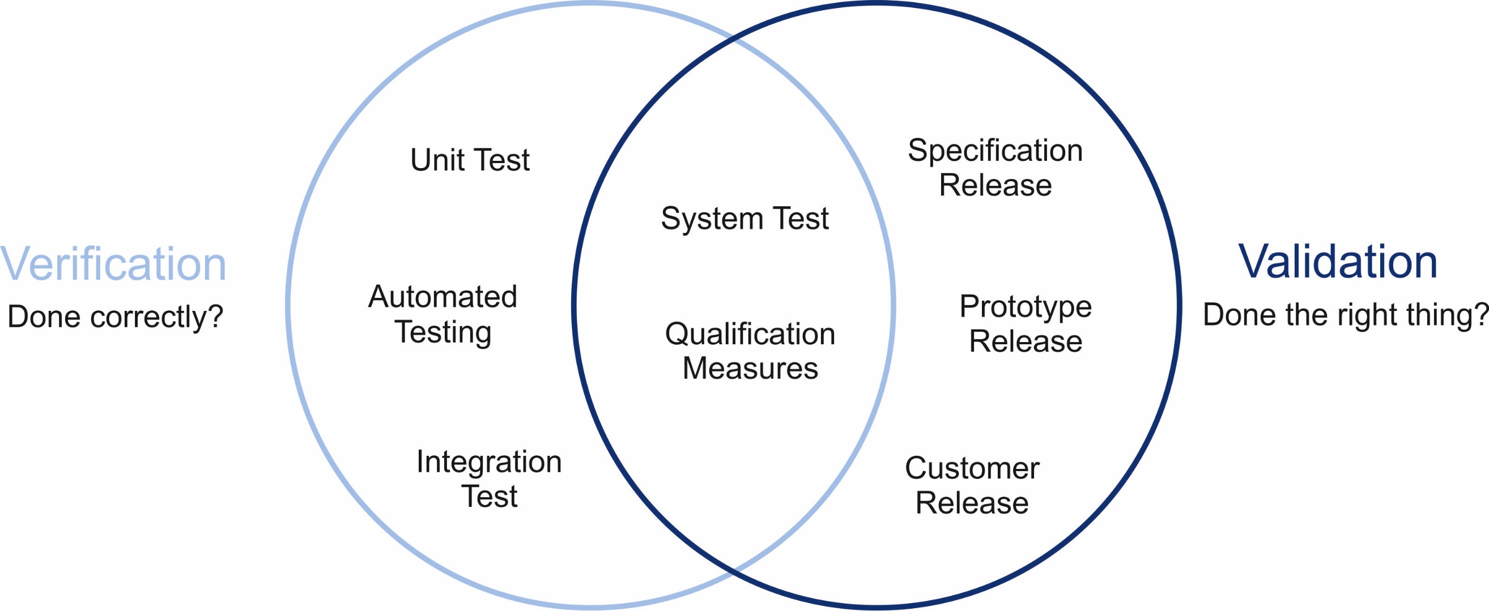
Validation vs. Verification

Slide 64
Software Testing in V&V
Testing can be done for verification and validation
Verification:
To find defects by executing a program in a test or simulated environment
e.g., functional test, integration test
Validation:
To find defects by executing a program in a real environment or with real users
e.g., usability test, beta test

Slide 65
Software Testing in Development Life Cycle

Slide 66
Software Qualities and Process
Qualities cannot be added after development
Quality results from a set of inter-dependent activities
Analysis and testing are crucial but far from sufficient.
Testing is not a phase, but a lifestyle
Testing and analysis activities occur from early in requirements engineering through delivery and subsequent evolution.
Quality depends on every part of the software process
An essential feature of software processes is that software test and analysis is thoroughly integrated and not an afterthought

Slide 67
The Quality Process
Quality process: set of activities and responsibilities
focused primarily on ensuring adequate dependability
concerned with project schedule or with product usability
The quality process provides a framework for
selecting and arranging activities
considering interactions and trade-offs with other important goals.

Slide 68
Testing Activities in Life Cycle
For every development activity there is a corresponding testing activity
Development phases, development levels
Each test level has objectives specific to that level
Test design should start as early as possible
as soon as relevant documents are available
Applicable to waterfall and agile development model

Slide 69
Levels of Granularity of Testing
Unit (component, module) testing
Integration testing
System testing
Acceptance testing

Slide 70
The V-Model of – Validation & Verification
Actual Needs and Constraints
User Acceptance (Alpha, Beta Tests)
Delivered Package
Review
System Integration
System Specifications
System Test
Review/Analysis
Validation
Subsystem Design/Specs
Subsystem
Integration Test
Verification
Review/Analysis
Unit/Component Specs
Unit/Components
Unit Test
User Review of External Behavior

Slide 71
Unit Testing
Testing of individual software unit/module/components
Synonymous to module testing, component testing
Focus on the functions of the unit
functionality, correctness, accuracy
Usually carried out by the developers of the unit
Basis for unit testing
component specifications
detailed design and code

Slide 72
Integration Testing
Testing performed to expose defects in the interfaces and in the interactions between integrated components or sub-systems.
Focus on the interactions between modules
Usually carried out by the developers of the sub-systems involved
Basis for integration testing
system design and architecture
subsystem and interface specification

Slide 73
Regression Testing
Used when a large amount of testing is needed and the changes, while small, can affect many parts of the system.
Best example is in compiler development:
Collect selected examples of code that exercise each part of the compiler
Add new examples when a bug is detected
Run the compiler over the entire collection and capture the output
After any change of the code within the compiler, repeat the run
Compare with the baseline results

Slide 74
System Testing
Testing of an integrated system to verify that it meets the specification.
A.k.a. the end-to-end test
Verify functional and non-functional requirements
Carried out by the developers and independent testers
Basis for system testing
software requirement specification
functional specification

Slide 75
Acceptance Testing
Test the whole system to ensure that it meets the requirements
Focus on customer acceptance
Carried out by independent testers and the customers
Basis for acceptance testing
system and user requirements
use cases, business processes, risk analysis

Slide 76
Acceptance Testing & Criteria
Acceptance testing
Formal testing with respect to user needs, requirements, and business processes conducted to determine whether or not a system satisfies the acceptance criteria and to enable the user, customers or other authorized entity to determine whether or not to accept the system.
Acceptance criteria
The exit criteria that a component or system must satisfy in order to be accepted by a user, customer, or other authorized entity.

Slide 77
Acceptance Testing Techniques
Random (statistical) testing
Alpha testing
Beta testing

Slide 78
Acceptance Testing – Random Test
Random test (statistical test)
Test cases are selected randomly, possibly using a pseudo-random number generation algorithm, to match an operation profile, or usage profile.
Not the same as ad hoc testing

Slide 79
Acceptance Testing – Alpha Test
Simulated operational testing.
Performed by personnel acting as potential users/customers.
Carried out in a controlled environment.
Observed by the development organization.

Slide 80
Acceptance Testing – Beta Test
Operational testing to determine whether or not a component or system satisfies the user/customer needs and fits within the business processes.
Performed by real users in their own environment.
Perform actual tasks without interference or close monitoring

Slide 81
Artifacts to Facilitate Software Testing

Slide 82
Test Scaffolding
Additional code needed to execute a unit or subsystems in isolation for the purpose of testing.
e.g., test drivers, stubs
Not useful in production code
Needs to be removed.

Slide 83
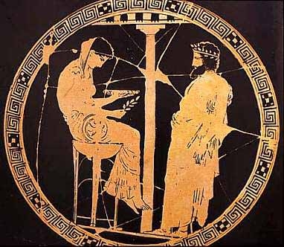
Test Oracles
A program to check the results of executing the code and signal discrepancies between the actual and expected outputs.
e.g., using assertions based on the specifications
Example: JUnit
The Oracle of Delphi

Slide 84
Summary: Key Concepts
Spectrum of software qualities
Metrics of quality attributes
Cost of software defects
V-model of validation and verification
Levels of granularity of testing
Unit, integration, system, acceptance test
Regression test
Test scaffoldings and oracles

